Slide 1

RADIOTHERAPY TO
ADDRESS CANCER BACKLOG
THERESE LINDÉ, RADIOTHERAPY UK, ADVAMED,
GLOBAL COALITION FOR RADIOTHERAPY (GCR)

Slide 2
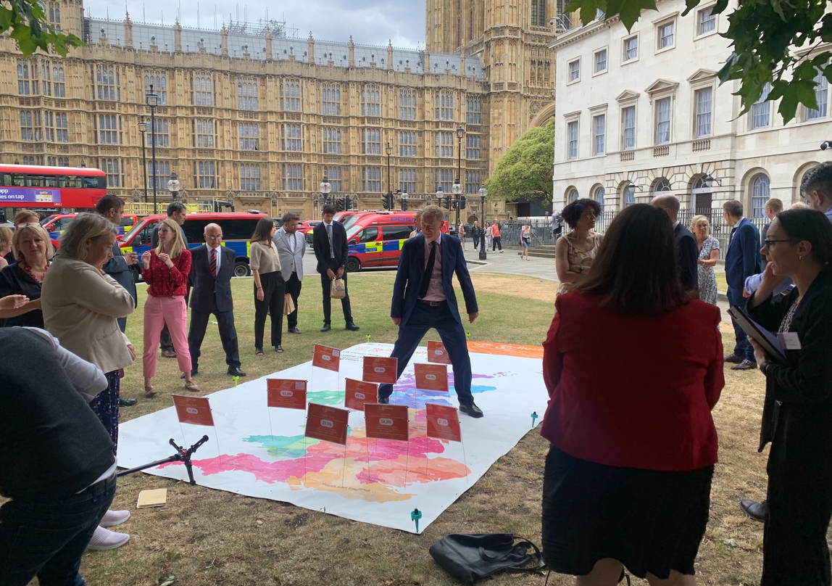





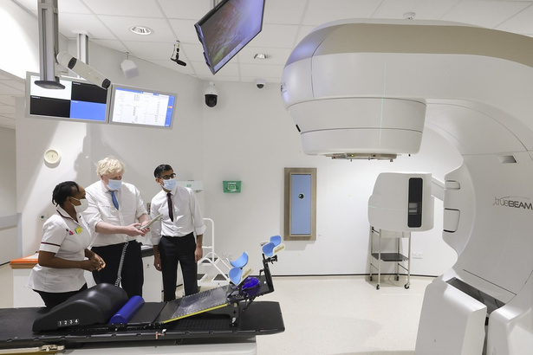


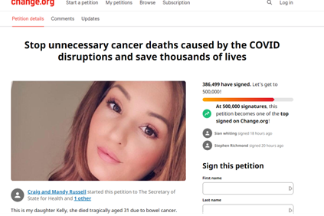
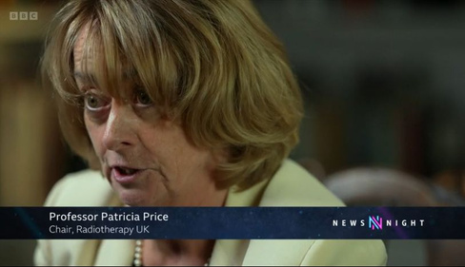

Challenges
Access to up-to-date equipment and technology to support digital transformation
Bureaucratic Tariffs that smother progress
Underutilisation of Radiotherapy - in the UK
only 27% of cancer patients access radiotherapy
Lack of leadership and vision
Powerful campaigning
Radiotherapy4Life and CatchUpWithCancer
All Parliamentary Party Group on Radiotherapy
Parliament events - Cancer Summit, Giant Maps showing regional waiting times
100 Parliamentarians, 385,000+ petition signatories, 130 Parliament Questions asked
Primetime media - BBC, Sky News, ITV
RADIOTHERAPY UK
Radiotherapy4Life campaign founded in 2018 bringing charities, patients, providers, professional bodies and industry together
Aim of improving access to high quality radiotherapy across the UK and reducing the Covid related backlog
The Lancet Oncology: “Radiotherapy is a crucial component of cancer treatment… not to be underestimated.”

Slide 3






WORKING
TOGETHER
GLOBAL COALITION OF RADIOTHERAPY (GCR)
The issues faced in the UK are reflected around the world
This need to tackle the issues on global scale inspired the development of the GCR
Stakeholders
The GCR brings together patients, charities, clinicians, scientists, health experts and industry partners to create a world where access to quality radiotherapy is
universal and equitable.
How it works
Hosting expert-led webinars and roundtables
Establishing a Radiotherapy Task Force to address global crises
Advocacy through collaboration – GCR Advocacy Toolkit
Educating with timely publications – GCR White Paper: Closing the Care Gap: How digital transformation, global networking and remote solutions could expand the reach of radiotherapy in communities worldwide

Slide 4


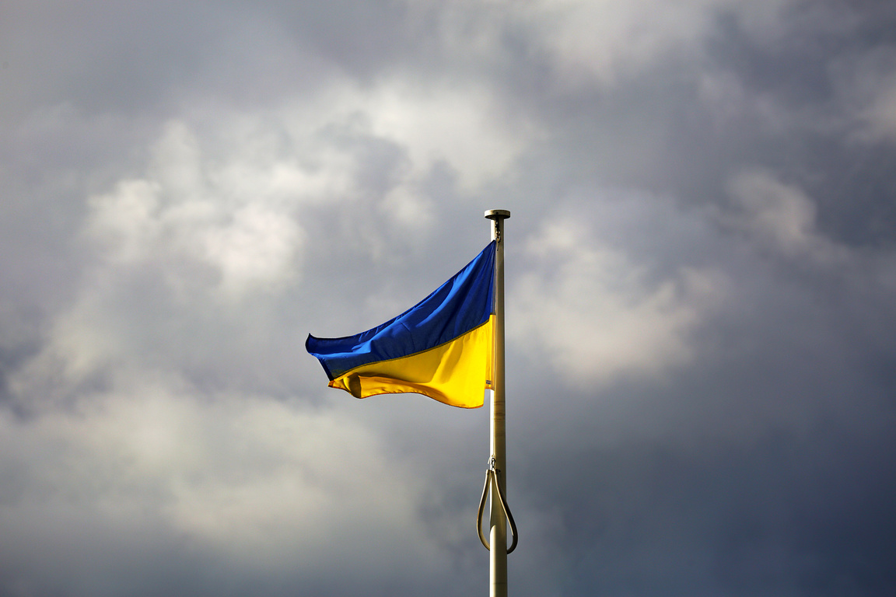




GLOBAL IMPACT
Working in collaboration to improve radiotherapy treatments for cancer patients across the world.
Responding to COVID Pandemic
Supporting RT provision in Ukraine
Future Plans
  Grow the network of global partners: every country, health plan and patient who needs radiotherapy care should have access.
  Address regional needs with Radiotherapy Task Force: response to Ukraine has proven the community’s collaborative ability to act quickly
  Harness digital capabilities of radiotherapy: digital transformation can make a big leap forward in equitable healthcare
CALL TO ACTION: Governments, politicians and healthcare structures must prioritize this life saving cancer treatment and close the care gap by investing in Radiotherapy today.

Slide 5

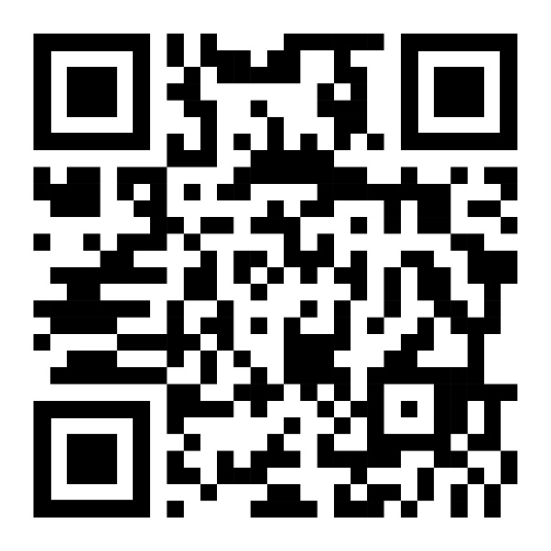
THANK YOU

